Slide 1
Automatic Suggestion of Query-Rewrite Rules for Enterprise Search
Date : 2013/08/13
Source : SIGIR’12
Authors : Zhuowei Bao, Benny Kimelfeld , Yunyao Li
Advisor : Dr.Jia-ling, Koh
Speaker : Shun-Chen, Cheng

Slide 2
Outline
Introduction
Recognizing Nature Rules
Optimizing Multi-Rules Selection
Experiments
Conclusions

Slide 3
Outline
Introduction
Recognizing Nature Rules
Optimizing Multi-Rules Selection
Experiments
Conclusions

Slide 4
Introduction
Enterprise Search
index data and documents from a variety of sources such as: file systems, intranets, document management systems, e-mail, and databases.
integrate structured and unstructured data in their collections.
dynamic terminology and jargon that are specific to the enterprise domain.
domain experts maintaining

Slide 5
Introduction
Relevant documents missing from the top matches.
administrators to influence search results by crafting query-rewrite rules
tedious and time consuming
Goal : ease the burden on search administrators by automatically suggesting rewrite rules.

Slide 6
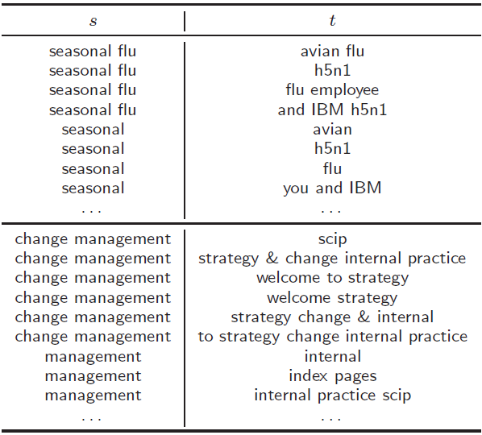
Two Challenges
Challenge1
Generating Intuitive Rules
corresponding to closely related and syntactically complete concepts
Solved by
machine-learning
classification approach

Slide 7
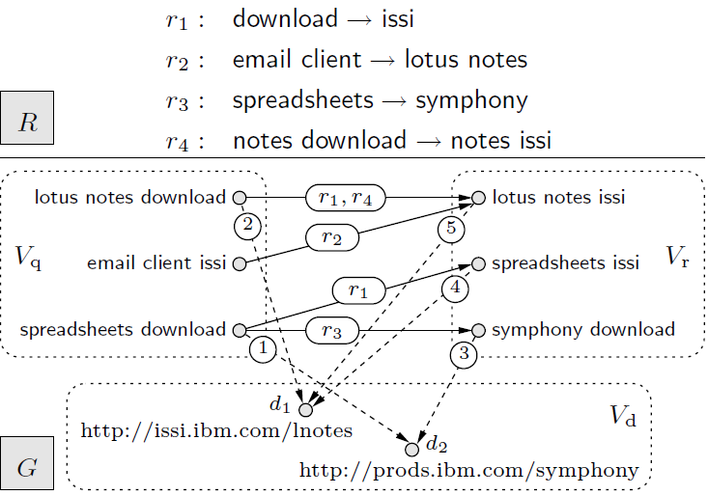
Challenge2
Cross-Query Effect
Query1 : spreadsheets download -> r3 -> symphony download -> d2 on top match
Query1 -> r1 -> spreadsheets issi -> pushing d2 below d1.
Propose a heuristic
approaches and optimization thereof

Slide 8
Outline
Introduction
Recognizing Nature Rules
Optimizing Multi-Rules Selection
Experiments
Conclusions

Slide 9
Recognizing Nature Rules(1/3)
Candidate generation
set S: all the n-grams (subsequences of n tokens) of q(5 in our implementation)
set T: T consists of the n-grams just from the high-quality fields of d
Candidate : Cartesian product S×T
Ex :
q=change management info
fields = welcome to scip strategy & change internal practice
Candidate:
management → scip
change → strategy & change internal
change management → scip strategy

Slide 10
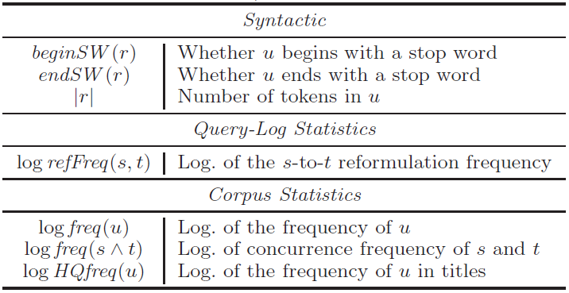
Recognizing Nature Rules(2/3)
Features
The considered rule is s → t, and u refers to either s or t

Slide 11
Recognizing Nature Rules(3/3)
Classification models
SVM
Decision Tree with linear-combination splits(rDTLC)

Slide 12
Outline
Introduction
Recognizing Nature Rules
Optimizing Multi-Rules Selection
Experiments
Conclusions

Slide 13
Optimizing Multi-Rules Selection(1/7)
W(q,d)

Slide 14
Optimizing Multi-Rules Selection(2/7)
q = spreadsheets download
Score(d|q)
the maximal weight of a path from q to d.
ex: score(d2|q)=3 ， score(d1|q)=4
the series of k documents with the highest w(q, d),
ordered in descending w(q, d).
ex:
top1[q|G] is the series (d1),
top2[q|G] (as well as top3[q|G]) is the series (d1, d2).

Slide 15
Optimizing Multi-Rules Selection(3/7)
quality measure μ：a quality score for each query q based on the series topk[q|G] and the set δ(q), for a natural number k of choice
MRR
DCGk(without labeled relevance)
topk[q|G] = (d1, . . . , dj), and each ai is 1 if di ∈ δ(q) and 0 otherwise.
top-k quality of G, denoted μk(G, δ)

Slide 16
Optimizing Multi-Rules Selection(4/7)
Ex: desideratum δ:
δ(lotus notes download) = δ(email client issi) = {d1}
δ(spreadsheets download) = {d2}
top1[q1|G] = (d1)
top1[q2|G] = (d1)
top1[q3|G] = (d1)
MRR at 1:
μ1(G, δ)=(1/1)+(1/1)+(0/2)
DCG1:
μ1(G, δ)

Slide 17
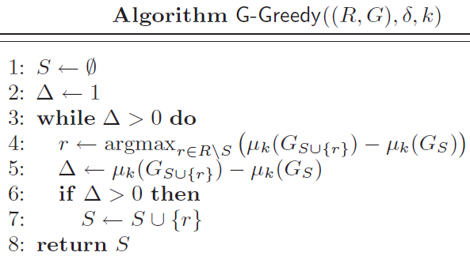
Optimizing Multi-Rules Selection(5/7)
G-Greedy

Slide 18
Example of G-Greedy(6/7)

Slide 19
Iteration1:
Candidate = r1，
Candidate=r2，
Candidate=r3，
Candidate=r4，

Slide 20
Iteration2:
Candidate=r1:
Candidate=r3:
Candidate=r4:
stop the algorithm

Slide 21
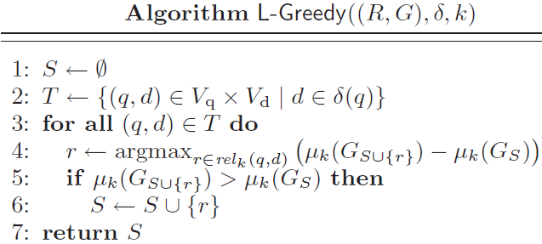
Optimizing Multi-Rules Selection(7/7)
L-Greedy

Slide 22
Outline
Introduction
Recognizing Nature Rules
Optimizing Multi-Rules Selection
Experiments
Conclusions

Slide 23
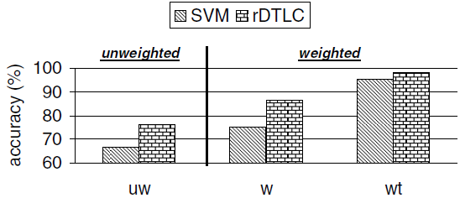
Experiments
Query log: 4 months of intranet search at IBM
Recognizing Nature Rules
randomly selected and manually labeled 1187 rules as either natural or unnatural.
Weight : query is weighted by the number of sessions where it is posed
Accuracy

Slide 24
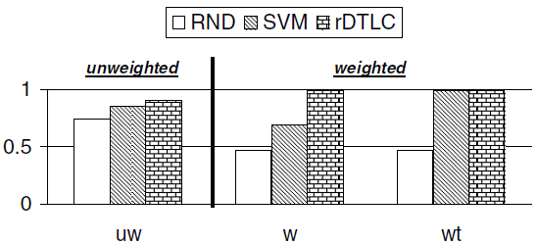
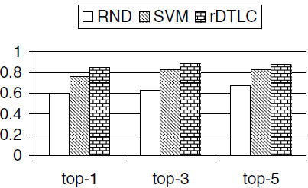
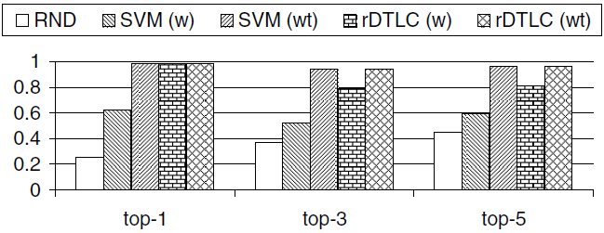
Experiments

Slide 25
Experiments
Optimizing Multi-Rules Selection
Measures : NDCGk、MRR (top-5)
Labeled Dataset: administration graph contains 135 queries, 300 rqueries, 423 documents, and a total of 1488 edges.
Extended Dataset:administration graph contains 1001 queries, 10990 r-queries, 4188 documents, and a total of 36986 edges

Slide 26
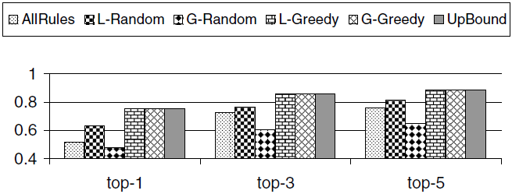
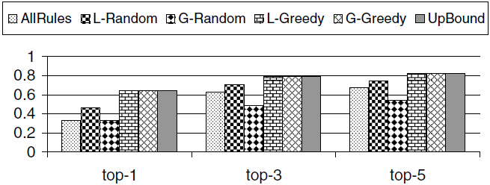
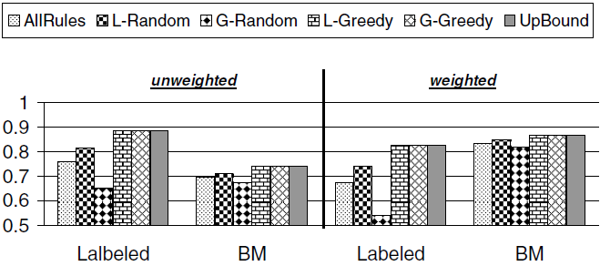
Experiments
Labeled Dataset
nDCGk (unweighted)
L-Greedy and G-Greedy score significantly higher than the other alternatives.
MRR
nDCGk (weighted)
L-Greedy and G-Greedy reach the upper bound

Slide 27
Experiments
Running time
locally greedy algorithms are over one order of magnitude faster than their globally greedy counterparts
optimized versions are generally over one order of magnitude faster than their unoptimized counterparts.
the optimized version of our locally greedy algorithm is capable of finding an optimal solution in real time for the typical usage scenarios

Slide 28
Outline
Introduction
Recognizing Nature Rules
Optimizing Multi-Rules Selection
Experiments
Conclusions

Slide 29
Conclusions
proposed heuristic algorithms to accommodate the hardness of the task(the problem of selecting rules).
Experiments on a real enterprise case (IBM intranet search) indicate that the proposed solutions are effective and feasible.
In future work, we plan to focus on extending our techniques to handle significantly more expressive rules.

